Slide 1







STUDENT NAME : DURGA J
REGISTER NO
: 2213331042089, asunm13332213331042089
: COMMERCE
: BHARATHI WOMENS COLLEGE
DEPARTMENT COLLEGE

Slide 2


Gvhh
Employee Performance Analysis

Slide 3
●
●
●
●
●
●
●
●
Problem Statement Project Overview End Users
Our Solution and Proposition Dataset Description Modelling Approach
Results and Discussion Conclusion

Slide 4




●
●
●
Ineffective identif ication of employee strengths and weaknesses
Lack of data-driven decision-making in performance evaluations
Inadequate feedback mechanisms and employee development plans

Slide 5


Comprehensive analysis of employee performance using multiple metrics Implementation of data-driven models to identify trends and insights
Aim to improve overall organizational productivity and employee satisfaction
●
●
●

Slide 6
HR Managers: For developing effective performance appraisal systems
Team Leaders: To understand team dynamics and performance levels Executives: To align employee performance with organizational goals
●
●
●

Slide 7





●
●
●
Develop a robust performance analysis framework
Use advanced analytics and machine learning models for performance prediction
propose actionable insights for enhancing employee engagement and productivity

Slide 8


Data collected from employee performance reviews, KPIs, attendance records, etc.
Includes qualitative and quantitative measures such as feedback scores, project completion rates, etc.
●
●
●
Dataset size: [Number of records] with [Number of features]

Slide 9




Use of regression models to predict employee performance trends
Classif ication models to categorize employees into performance tiers
●
●
●
clustering analysis to identify patterns and anomalies in employee data

Slide 10



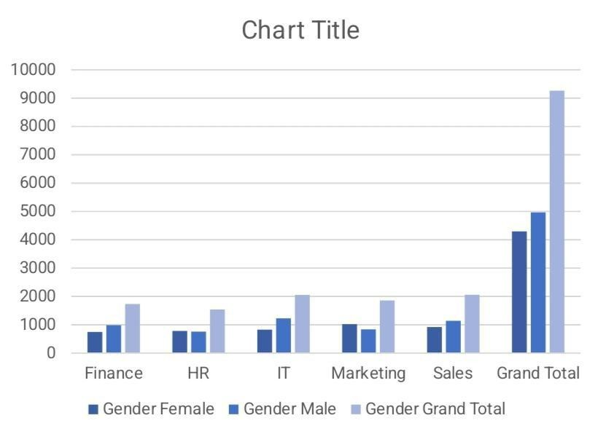
Key Findings: Identif ication of top- performing employees Analysis of factors
inf luencing employee performance
●
●
●
●
●
Areas for potential improvement Discussion on the implications of the f indings for future strategies

Slide 11






Summary of key insights derived from the analysis
Beneﬁts of implementing data-driven performance management Recommendations for ongoing monitoring and continuous improvement
●
●
●

